Slide 1
Metamorphic Rocks
Earth and Space Science

Slide 2
Metamorphic Rock – changed rock
- Rock formed when other rocks are changed due to heat, pressure, and or chemically
- Minerals in the rocks change to different minerals (metamorphosed)
- Most common methods
1.Heat \ *not enough heat to melt the rocks
2. Heat and pressure / Causes a chemical change to occur
ex. Original rock Metamorphic rock
Limestone ----→ Marble
Shale ----→ Slate

Slide 3
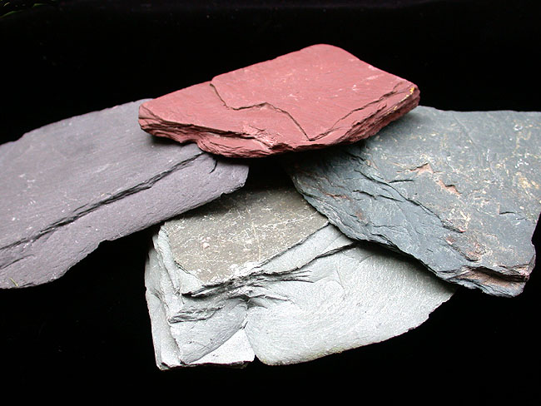
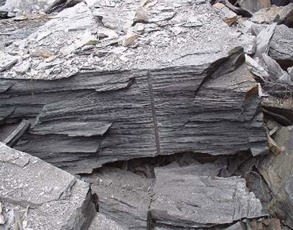
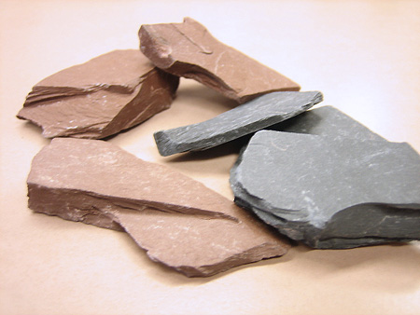
Slate
Used to be Shale
Has layers = FOLIATED
Very flat appearance
Our sample is dark grey, but can be one of several colors

Slide 4
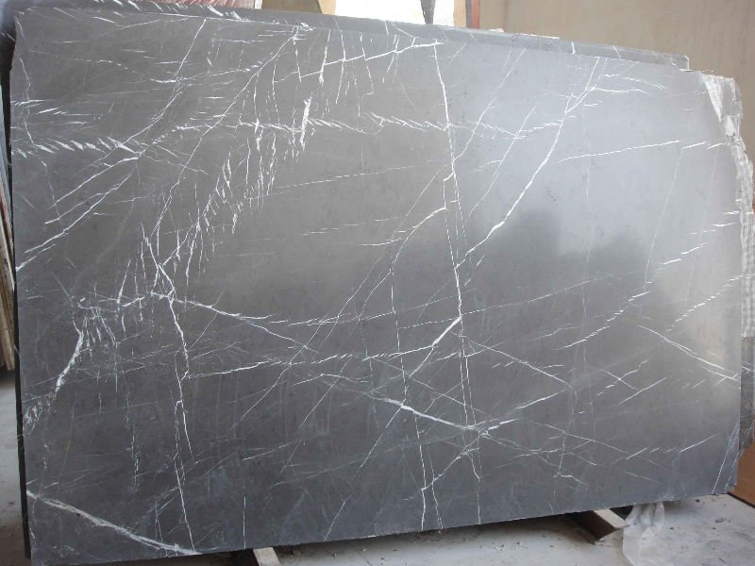
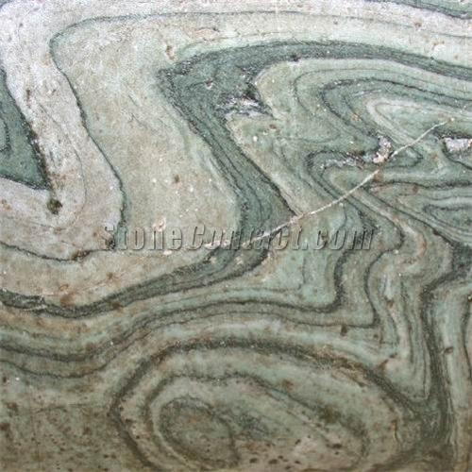
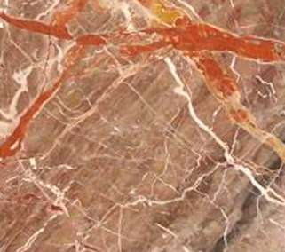
Marble
Used to be Limestone
Has NO layers = UNFOLIATED
Can see the crystals in our sample, but can be polished as well
Our sample is white, but can be one of several colors, or a mix of colors

Slide 5
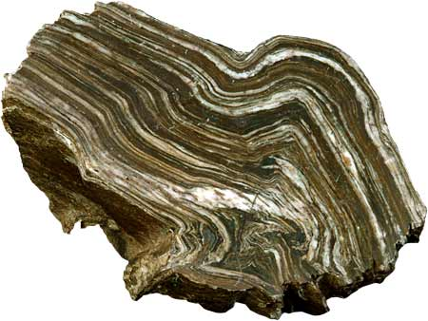
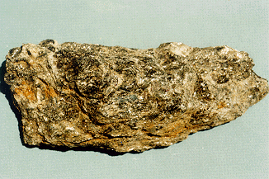
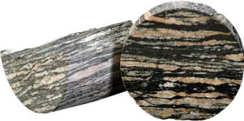
Schist
Used to be Slate
Has layers = FOLIATED
Very flat, thin, crinkly appearance
Our sample is goldish colored, but can be one of several colors

Slide 6
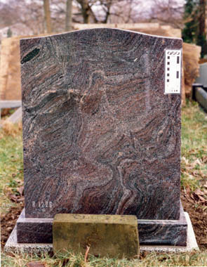
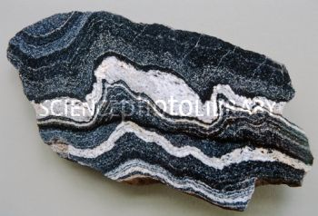
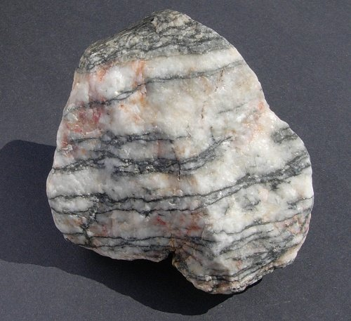
Gneiss
Used to be Schist or Granite
Has layers = FOLIATED
Our sample has black bands / layers with some visible crystals
Our sample is greyish pink with black stripes, but can be one of several colors

Slide 7
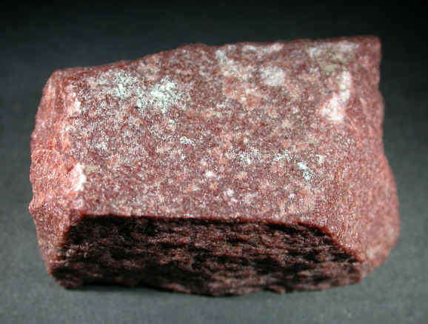
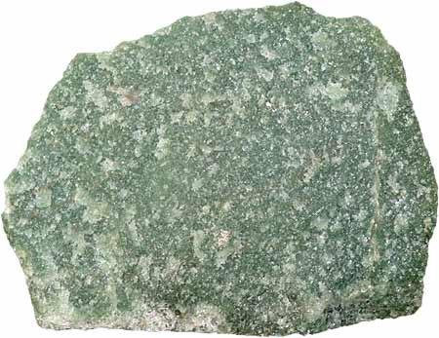
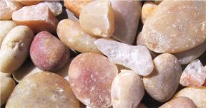
Quartzite
Used to be Quartz sandstone
Has NO layers = UNFOLIATED
Rough appearance with tiny crystals
Our sample is white to grey to pink, but can be one of several colors, or a mix of colors

